Slide 1
KOORDYNATOR
Complete Event Management Solution

Slide 2
Description of Project

Slide 3
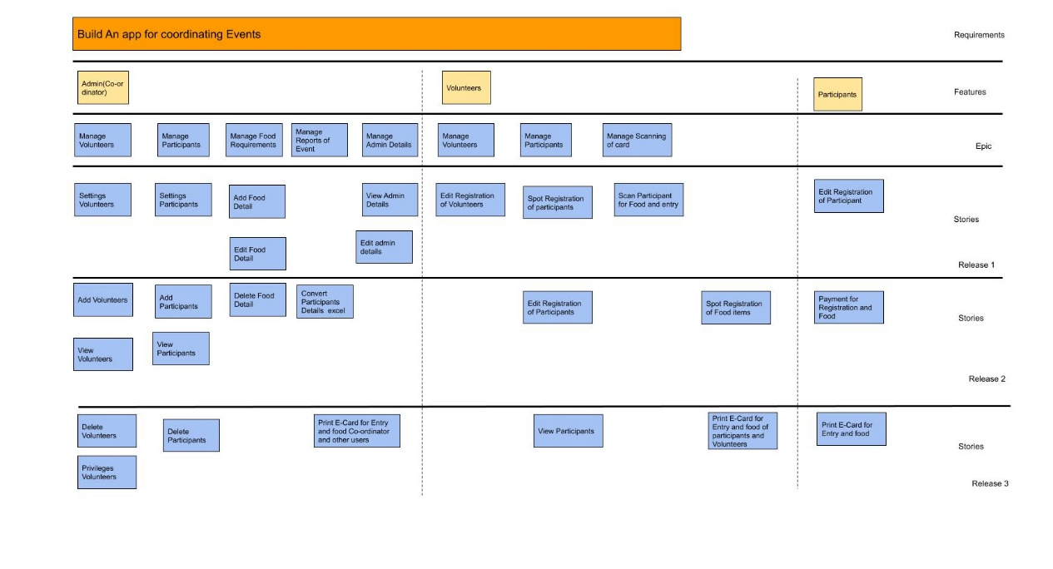
User Story

Slide 4
DFD

Slide 5
Table Design

Slide 6
Git History

Slide 7
Gantt chart

